Slide 2
Adventist Understanding of Inspiration
Historical Overview
by Alberto R. Timm

Slide 3
Three Controversial Issues
Prophetic inspiration
Hermeneutics of the inspired writings
Relationship to culture

Slide 4
“All Scripture is given by inspiration of God, and is profitable for doctrine, for reproof, for correction, for instruction in righteousness, that the man of God may be complete, thoroughly equipped for every good work” (2 Tim 3:16-17).

Slide 5
What is prophetic inspiration?
“Defining inspiration is like catching a rainbow. When we have put forth our best efforts, there will remain an elusive factor, and element of mystery.”
William G. Johnsson, "How Does God
Speak?" Ministry, Oct. 1981, 4

Slide 6
thought (ideas)
verbal (writings)
THEORIES
mechanical (words)
plenary (whole process)

Slide 7
HISTORICAL OVERVIEW

Slide 8
The Millerite Legacy
(pre-1844)
William Miller
Deist > inconsistences and contradictions
Believer > overall harmony

Slide 9
Early SDA Views
(1844-1883)
Emphasis on verbal inspiration and inerrancy
Moses Hull (1863)
Nothing in the Bible contradicts any of the sciences of “physiology, anatomy, hygiene, materia medica, chemistry, astronomy, or geology.”
Moses Hull, The Bible from Heaven, 168-169

Slide 10
Reprints in the Review:
Early SDA Views
(1844-1883)
1859 – Louis Gaussen’s Theopneustia
Emphasis in verbal inspiration and inerrancy
Not “one single error” can be found in the more than 31,000 verses of the Bible.
Moses Hull (1863)
1880 – J. H. Pratt’s Scripture and Science Not at
Variance
Nothing in the Bible contradicts any of the sciences of “physiology, anatomy, hygiene, materia medica, chemistry, astronomy, or geology.”
Moses Hull, The Bible from Heaven, 168-169
The Holy Sprit preserved the writers of the Bible “from
errors of every kind in the records they made.”
1883 – H. L. Hastings
The Scriptures as “the transcript of the Divine Mind.”

Slide 11
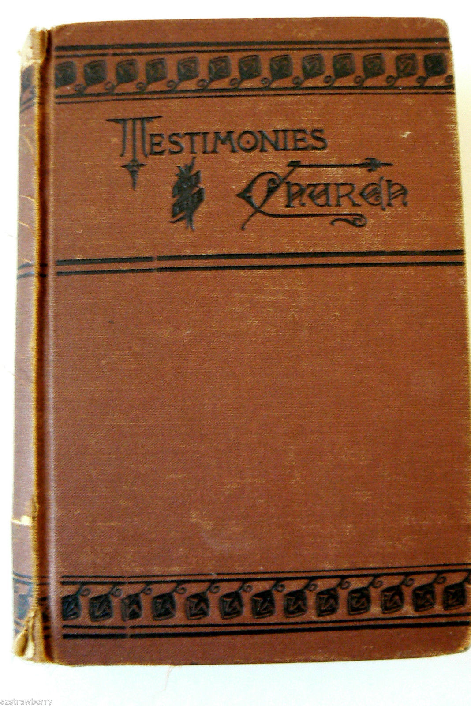
Focus on the Nature of Inspiration (1883-1915)
Emphasis on thought inspiration
Revision of E. G. White’s Testimonies for the Church

Slide 12
1883 General Conference Session
“Whereas, Many of these testimonies were written under the most unfavorable circumstances, the writer being too heavily pressed with anxiety and labor to devote critical thought to the grammatical perfection of the writings, and they were printed in such haste as to allow these imperfections to pass uncorrected; and—
“Whereas, We believe the light given by God to his servants is by the enlightenment of the mind, thus imparting the thoughts, and not (except in rare cases) the very words in which the ideas should be expressed; therefore—
“Resolved, That in the republication of these volumes such verbal changes be made as to remove the above‑named imperfections, as far as possible, without in any measure changing the thought.”
– RH, Nov. 27, 1883, 741-742

Slide 13
Degrees of inspiration?
Uriah Smith (1883) > Ellen G. White
Inspired “visions”
Uninspired “testimonies”
George I. Butler (1884) > Bible
Five degrees of inspiration
Ellen G. White (1889) > response
“The Lord did not inspire the articles on inspiration published in the Review.”

Slide 14
Ellen White’s view of inspiration
Incarnational understanding:
“But the Bible, with its God-given truths expressed in the language of men, presents a union of the divine and the human. Such a union existed in the nature of Christ, who was the Son of God and the Son of man. Thus it is true of the Bible, as it was of Christ, that ‘the Word was made flesh, and dwelt among us’” (GC v).

Slide 15
Response to mechanical and verbal inspiration:
“It is not the words of the Bible that are inspired, but the men that were inspired. Inspiration acts not on the man's words or his expressions but on the man himself, who, under the influence of the Holy Ghost, is imbued with thoughts. But the words receive the impress of the individual mind” (1SM 21).
➔ Rephrased from Calvin E. Stowe (reprinted in
the Review)

Slide 16
Response to seminal thought inspiration:
“The scribes of God wrote as they were dictated by the Holy Spirit, having no control of the work themselves” (4T 9).
“I just as dependent upon the Spirit of the Lord in relating or writing a vision, as in having the vision” (1SM 36).
“I gave myself, my whole being, to God, to obey His call in everything, and since that time my life has been spent in giving the message, with my pen and in speaking before large congregations. It is not I who controls my words and actions at such times” (1SM 39).

Slide 17
Balance between the two responses:
“Although I am as dependent upon the Spirit of the Lord in writing my views as I am in receiving them, yet the words I employ in describing what I have seen are my own, unless they be those spoken to me by an angel, which I always enclose in marks of quotation” (1SM 37).

Slide 18
The Modernist-Fundamentalist Controversy
(1915-1950)
Emphasis on verbal inspiration and inerrancy
Death of Ellen White (1915)
“Christian Fundamentals” Conference (May 1919)
Bible and History Teachers’ Council (July-August 1919)

Slide 19
Benjamin L. House (1926) quoted William Evans:
Since inspiration is “God speaking through men,” the Old Testament is “just as much the Word of God as though God spake every single word of it with His own lips.”
Benjamin L. House, Analytical Studies in Bible Doctrine, 60

Slide 20
Holding to “Verbal or Plenary Inspiration,” House rejected:
concept or thought inspiration, for leaving the Bible writers “absolutely to themselves in the choice of words they should use”
mechanical or dynamic inspiration, for no accounting for “the different style of the various writers” and for “the material secured from historical records”
natural inspiration, for denying “the supernatural and the mysterious in the Bible”
illumination or universal Christian inspiration, for holding that “the Christians of every age have been inspired just the same as the Bible writers”

Slide 21
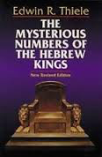
Edwin R. Thiele, “The Chronology of the Kings of Judah and Israel” (Ph.D. diss., University of Chicago, 1943)
Book version

Slide 22
The Emergence of New Trends
(1950-1970)
Emphasis on thought inspiration
Carl W. Daggy, “A Comparative Study of Certain Aspects of Fundamentalism with Seventh-day Adventism” (M.A. thesis, Seventh-day Adventist Theological Seminary , 1955)
Seventh-day Adventist Bible Commentary (1953-1957)
Frederick E. J. Harder, “Revelation, a Source of Knowledge, as Conceived by Ellen G. White” (Ph.D. diss., New York University, 1960)

Slide 23
The Historicization of Inspired Writings
(1970-1991)
Autumn-1970 issue of Spectrum > several articles
on Ellen White
Main issues:
Encounter Revelation
Historical-Critical Method

Slide 24
Globalization
Anti-Trinitarianism
Traditionalism
Ancient
Tradition
1844
1880
1890
1970
1998
Liberalism
Modern
Culture
Internet

Slide 25
Benjamin McArthur, “Where Are Historians Taking the Church?” Spectrum 10 (Nov. 1979): 9-14
Seventh-day Adventism is “witnessing the first great age of Adventist historical revisionism.”
“Orthodox belief and critical historical judgment are incompatible.”
“The problem is not that the Adventist historian lacks faith in God’s providential leading, but that there is no way for them to include it in historical explanation.”
D. R. McAdams, “Shifting Views of Inspiration,” Spectrum 10 (Mar. 1980): 27-41

Slide 26
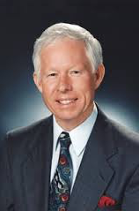
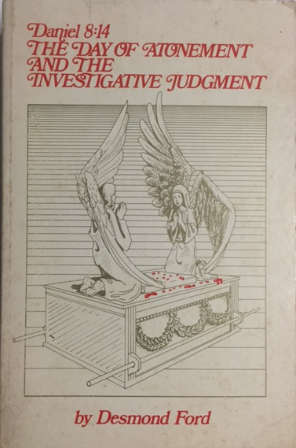
Desmond Ford, Daniel 8:14, The Day of Atonement, and the Investigative Judgment (Casselberry, FL: Euangelion Press, 1980), 350-361

Slide 27
Walter T. Rea, The White Lie (Turlock, CA: M & R Publications, 1982)

Slide 28
Alden Thompson, “From Sinai to Golgotha,” 5-part series in Adventist Review, Dec. 3, 1981, 4-6; Dec. 10, 1981, 8-10; Dec. 17, 1981, 7-10; Dec. 24, 1981, 7-9; Dec. 31, 1981, 12-13.

Slide 29
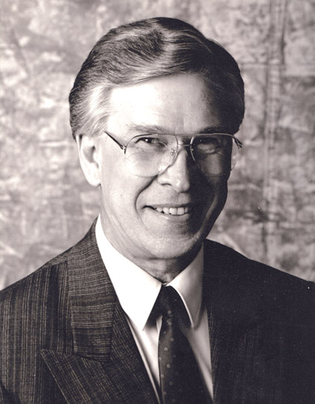
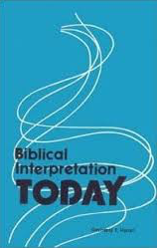
Conservative responses:
Biblical Research Committee of the General Conference
Gerhard F. Hasel
Ed E. Zinke
Raoul Dederen
Other authors

Slide 30
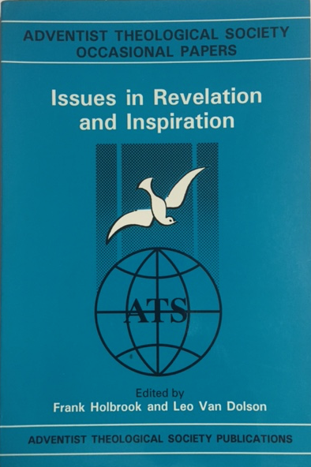
Conflicting Views of Inspiration
(1991- )
Alden Thompson, Inspiration: Hard
Questions, Honest Answers (Hagerstown,
MD: Review and Herald, 1991)
Frank Holbrook and Leo van Dolson, eds.,
Issues in Revelation and Inspiration
(Berrien Springs, MI: Adventist
Theological Society Publications, 1992)

Slide 31
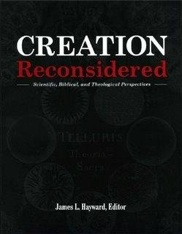
Raymond F. Cottrell, “Inspiration and Authority
of the Bible in Relation to Phenomena of the
Natural World,” in James L. Hayward, ed.,
Creation Reconsidered: Scientific, Biblical, and
Theological Perspectives (Roseville, CA:
Association of Adventist Forums, 2000), 195-221.
“The inspired message on record in the Bible” is “culturally conditioned” and “historically conditioned.”
“Historical conditioning permeates the entire Bible. It is not incidental, nor is it exceptional or unusual; it is the invariable rule.”

Slide 32
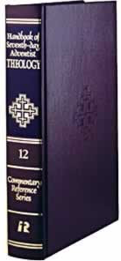
Peter M. van Bemmelen, “Revelation and Inspiration,” in Raoul Dederen, ed., Handbook of Seventh-day Adventist Theology, Commentary Reference Series, vol. 12 (Hagerstown, MD: Review and Herald, 2000), 22-57

Slide 33
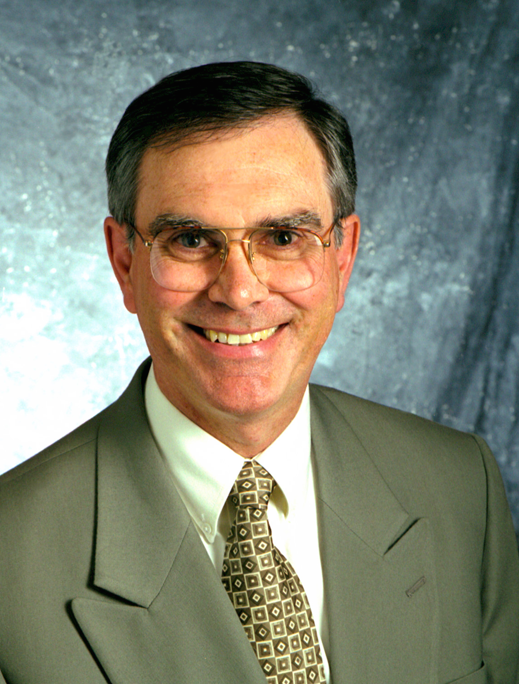
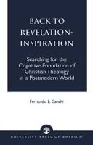
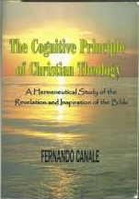
Fernando L. Canale, Back to Revelation-Inspiration: Searching for the Cognitive Foundation of Christian Theology in a Postmodern World (Lanham, MD: University Press of America, 2001)

Slide 34
Concluding Remarks
Our understanding of inspiration has followed
a pendulum motion.
We should allow the Bible to say what it has to say
about its own mysterious nature.
Our studies of the Bible should not overshadow its
transforming power.

