Slide 1
Adventism & Fundamentalism: Part 1
Michael W. Campbell, Ph.D.
mcampbell@swau.edu

Slide 4
Notes:
May 7, 1915 German U-boat torpedoed a British ocean liner, the Lusitania, near the coast of Ireland (133).
More than 1k people died including 128 Americans.
President Wilson protested in strongest terms (eager to stay out of war)
William Jennings Bryan felt forced to resign > American entry into war inevitable.
Two years later Bryan was correct >
Spring of 1917 Germany engaged in unrestricted warfare and soon sank five American merchant vessels > Wilson declared war on April 2, 1917.
Act of War > “proved to be one of the major turning points in the history of American evangelicalism.”
Prior to war > visitor from another country would have found Protestantism default religion of US
Evangelicalism predominant form of Protestantism

Slide 5
Notes:
Claimed more than 10 million military casualties! 60 million mobilized. (USA 114k casualties).
Trench system extended 475 miles! Death at an unimaginable scale:
Poison gas
First World War was a thoroughly religious event as overwhelmingly Christian nations fought one another.
Destroyed global religious order (Jenkins, pg. 5). As a Christian war, the startling literalism placed Christ on the battle lines.
WORLD OF RAPID CHANGE!
“Taken together, war, epidemic, and globalization made for an overpowering historical devil’s brew” (Jenkins, 17).

Slide 6
Notes:
Led to severe restrictions on freedom of speech.
At least 250 German Adventists would die during the conflict.
Bigger problem: Uriah Smith’s “King of the North” interpretation was proven false (see McArthur, 366-367).
When the opposite thing happened with Turkey, people began to question whether Adventist interpretation of prophecy was correct (Land, Adventism in America, 132).
Most intense spiritual excitement in late 1917 > apocalyptic hopes ran high (Jenkins, pg. 18).
Carthaginian peace > where one side tries to annihilate the other.
Most powerful weapon > food.
Massacres by Ottoman Turks
German overlords had a strong ideology of racial supremacy.
Jews source of evils of modern world.

Slide 9
Prophetic Conferences

Slide 11
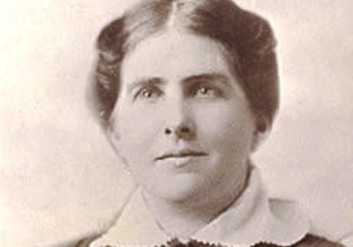
Margaret Rowen

Slide 12
Margaret Rowen
Converted from Methodism in 1912 and joined the South Side Los Angeles Church.
She claimed to receive a vision on June 22, 1916.
She began a periodical, The Reform Advocate and Prayer Band Appeal. She also authored a tract, A Stirring Message for the Time (1918).
The Southern California Conference investigated her claims, but they were inconclusive. By 1918 A. G. Daniells concluded that her visions were not of heavenly origin. On Nov. 15, 1919, she with Bert B. Fullmer, and two others were disfellowshipped.
Notes:
In the autumn of 1919 Margaret Rowen claimed to see a document in the manuscript files of the White Estate, dated August 10, 1911, in which Ellen White stated that Rowen would be a future messenger of God.
When W. C. White, son of Ellen White and secretary of the White Estate Board, looked through the manuscript files he found the document. However, it also bore the immediate evidence of forgery: the sheets were not perforated like other documents in the file, the typeface was different, there was no document file number, Ellen White was not in St. Helena when the document was dated, and the signature was a demonstrable forgery.
There was one possible answer. W. C. White’s young son, Arthur White, then only 12 years old, had given a tour of the Elmshaven vault containing all of Ellen White’s original writings. During the tour the lights had gone out. The young Arthur left the visitors in the vault while he went for a lantern. A small beam of light shone down on one of the manuscript files. That was the drawer where the spurious manuscript was found. The young Arthur, during a moment of carelessness, had contributed to a controversy that would continue for another eight years. It was a mistake he would never live down. Even in his later years when the White Estate vault doors had to be replaced, Arthur White brought in a cot and slept in the doorway to ensure the integrity of the White Estate files.3

Slide 14
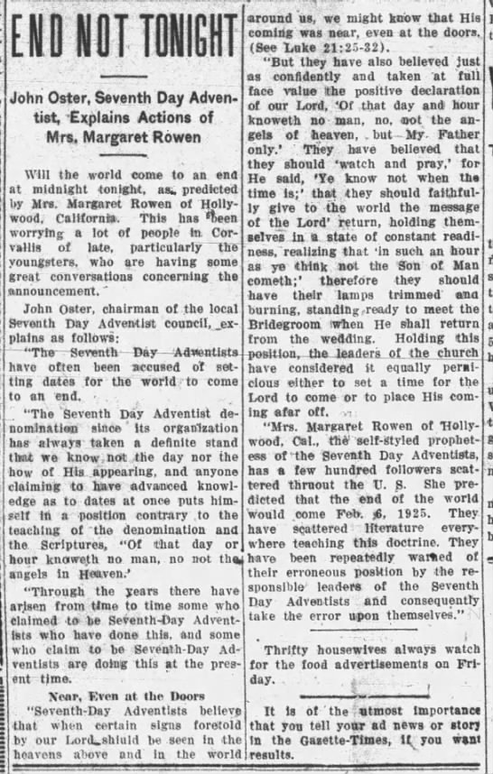
Second Advent
Notes:
In November 1923 she announced that the close of probation would occur on February 6, 1924, and that Christ would come in glory on February 6, 1925. This sensational announcement received widespread media attention and brought embarrassment to Seventh-day Adventists. When Rowen’s time prediction failed, her band of followers began to disintegrate.

Slide 16
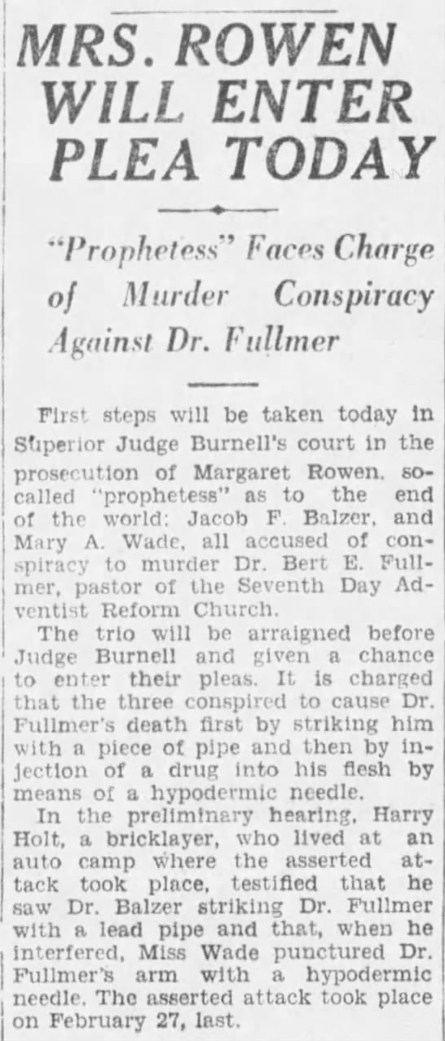
Notes:
One of Margaret Rowen’s earliest supporters and largest financial backers was Burt E. Fullmer, a physician in the Los Angeles area. Shortly after the failed time predictions he discovered that Margaret Rowen had been stealing from her own organization. Disenchanted with the lack of integrity manifested by such actions, he confessed on March 12, 1926, to playing the part of inserting the spurious Ellen White manuscript into an open drawer at the White Estate vault.
During a time when physicians made house calls, Dr. Fullmer received a call late at night for medical attention at a nearby motel. As he entered the room he was struck on the head with a piece of pipe. The police were summoned by nearby motel guests who had heard a commotion. As the police arrived on the scene they found Rowen with two conspirators with a shovel, burlap sack, and rope. The three fled the scene but were quickly apprehended.

Slide 17
Caught

Slide 19
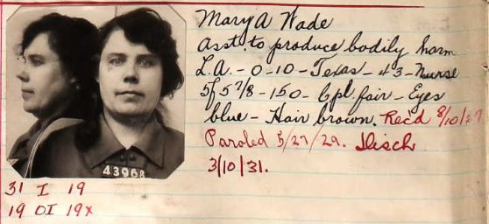
Accomplices

Slide 20
Prison Record

Slide 21
Dr. Fullmer

Slide 23
Tests of a Prophet
“To the law and to the testimony: if they speak not according to this word, it is because there is no light in them” (Isaiah 8:20).
“By your fruits you shall know them” (Matthew 7:20)
“When the word of the prophet shall come to pass, then shall the prophet be known, that the Lord has truly sent him” (Jeremiah 28:9).
“Every spirit that confesses that Jesus Christ is come in the flesh is of God” (1 John 4:2)

Slide 24
Adventism & Fundamentalism: Part 2
Michael W. Campbell, Ph.D.
mcampbell@swau.edu

Slide 25
The Bebbington Quadrilateral
Evangelism
Crucicentrism
Conversionism
Biblicism

Slide 26
What is Fundamentalism?
Origins are as primarily a religious movement.
Shaped primarily out of the American evangelical Protestant cultural experience.
The rising historical Fundamentalist movement shared a profound sense of spiritual/cultural crisis in the twentieth-century.
They had very definite ideas of where things had gone wrong:
Modernism
Theory of evolution
Notes:
These had caused the catastrophe by undermining biblical foundations of American civilization.

Slide 27
Fundamentalist Impulse
The rising “movement” took on its identity as a patchwork coalition with representatives from other movements.
The seriousness of the threat meant that Fundamentalism is best defined in terms of these concerns.
Fundamentalism is therefore defined as anti-modernist Protestant evangelicalism.
“Fundamentalism was a loose, diverse, and changing federation of co-belligerants united by their fierce opposition to modernist attempts to bring Christianity into line with modern thought” (George M. Marsden, Fundamentalism and American Culture, 2nd ed., pg. 4).

Slide 29
Lyman & Milton Stewart
Notes:
Standard Oil Company

Slide 31
Prophetic Conferences

Slide 32
Niagara Falls 1876-1900
Rise of dispensationalism.
Influenced a number of later leaders, most notably Dwight L. Moody.
In 1878 developed the fourteen point Niagara Creed including one of the points on eternal hellfire.
This was an deliberate attempt to exclude a few Seventh-day Adventists who made themselves abnoxious.
Notes:
The Niagara Bible Conference, held annually between 1876 and 1900, influenced thousands of American preachers towards dispensational premillenialism. In 1878, the conference organizers wrote the Niagara Creed, one of the foundational documents in the development of American fundamentalism. The success of the conference spawned hundreds of imitation conferences around the country, including one founded by popular evangelist Dwight L. Moody in Northfield, Massachusetts.

Slide 33
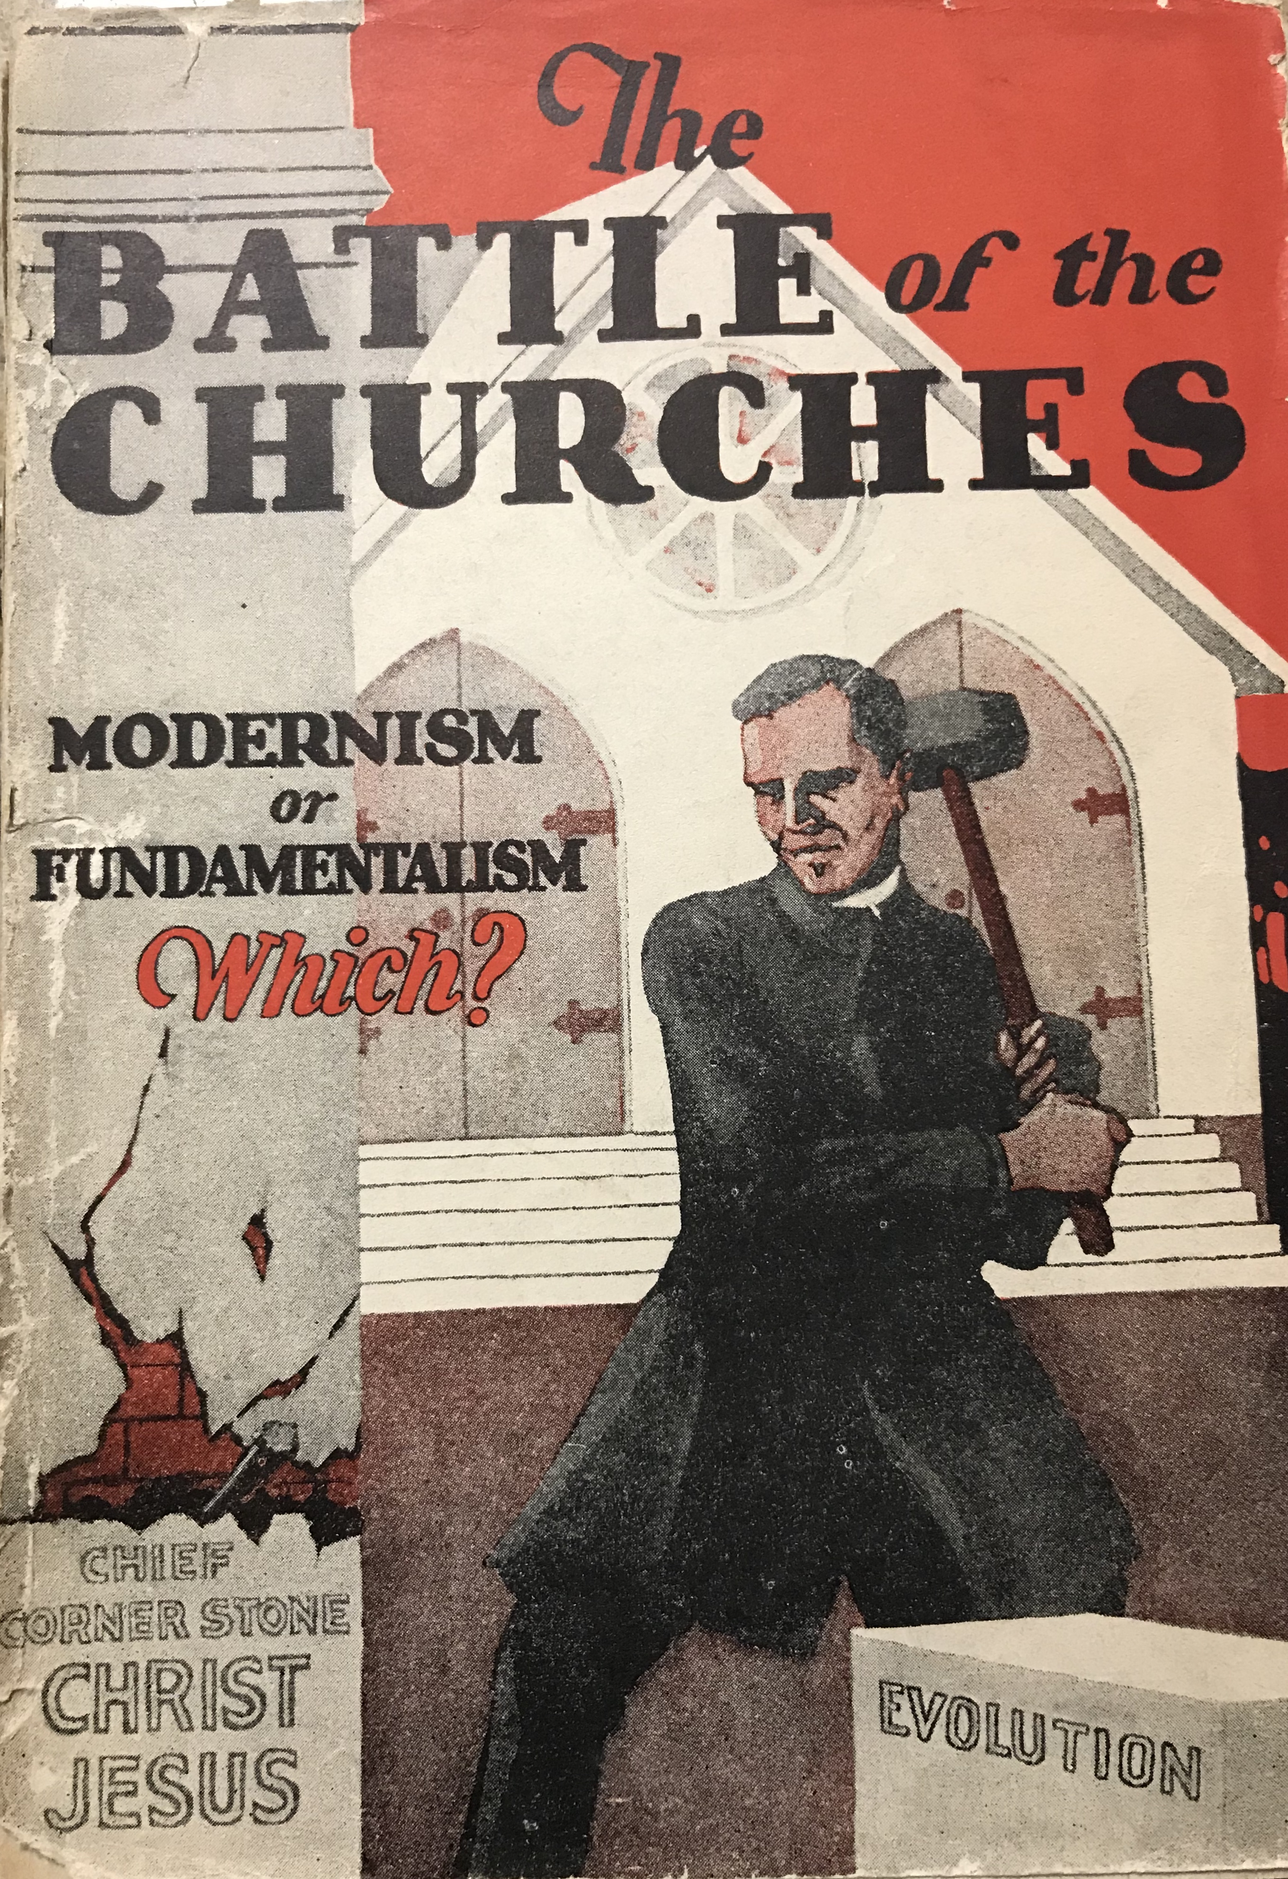

Slide 35
Sharp Divide

Slide 36
Adventists & Fundamentalism
Are Seventh-day Adventists Fundamentalist?

Slide 37
Adventism & Fundamentalism
1909 Presbyterian List of Beliefs:
Inerrancy
Christ’s Virgin Birth
Substitutionary Atonement of Christ
Physical Resurrection of Christ
Reality of miracles
Seventh-day Adventists could affirm all but the point on inerrancy!
Notes:
GC issued a statement of beliefs where Adventists stood.
Three articles/statements of faith:
Inspiration and divine inspiration of the Bible.
Adventists believed in a six day creation
Adventists believe in miracles including resurrection and Second Coming.
Church declined to endorse a particular kind of inspiration.
Plenty of Adventists believed that theory but never made official.
Lines up with Presbyterian five points of Fundamentalism
This was done in 1909:
Inerrancy
Christ’s virgin birth
IJesuss’ subsittuation atonement
Jeussu physical resurrection
Reality of miracles
GC Statement lines up with 4 out of 5 Fundamentalist points > only point of difference was to ignore the inerrancy of the Bible.
Most Adventists believed this even if not made official.

Slide 38
Mark A. Noll
“The fundamentalist era remains critical for evangelical thinking, since it so thoroughly established habits of mind for looking (or not looking) at the world. It greatly encouraged a set of intellectual instincts that still, after a century filled with change, exert a pervasive influence over the thinking of evangelicals. Fundamentalism was important for encouraging several kinds of simple anti-intellectualism, for reinforcing some of the questionable features of the nineteenth-century American evangelical synthesis, and for promoting right conclusions with the wrong kind of thought. The result was a tendency toward a docetism in outlook and gnosticism in method that together constitute the central intellectual indictment against the fundamentalism of the past” (The Scandal of the Evangelical Mind, 122-123).
Notes:
How do we deal with change?

Slide 39
Harry Emerson Fosdick
Decried lack of courtesy and kindness among Fundamentalists.
Lost his job by starting a culture war but had back of Rockefeller family to share this sermon and build him his own church.
Started a culture war.

Slide 40
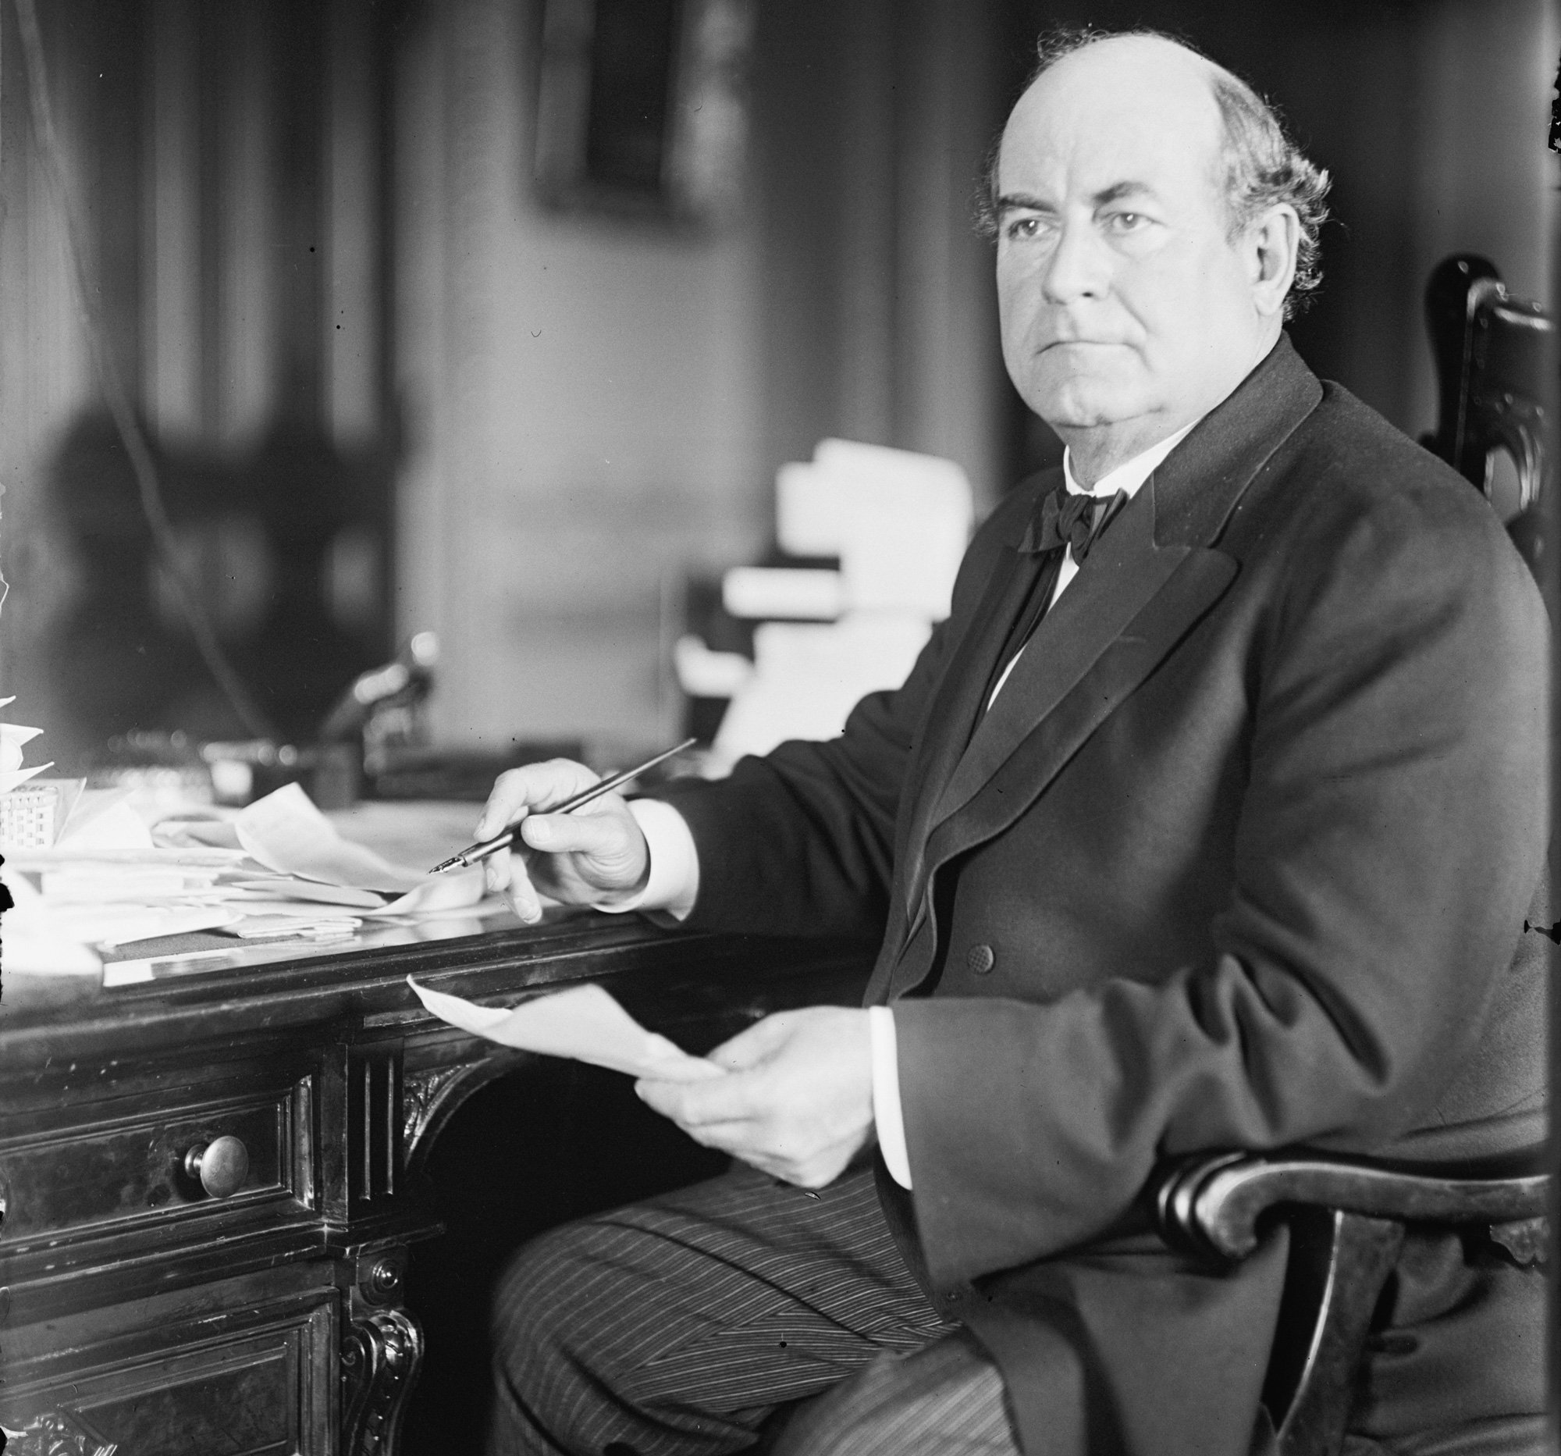
William Jennings Bryan
Notes:
William Jennings Bryan
NYT 1922 > evolution not a scientific fact, just a hypothesis
Believed like most people that religion was only means of morality
Not scientifically sound, but was shrewd > acknowledge they were atheists
Did at a time when most Americans were Christians > bating them > just admit you are an atheist.
William Jennings Bryan spoke at Union College several times.
When Bryan died GC voted to send a note of condolence to his wife.

Slide 41
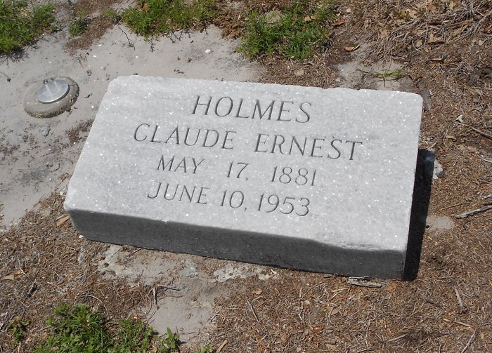
Holmes & Washburn

Slide 42
Pamphlet War

Slide 43
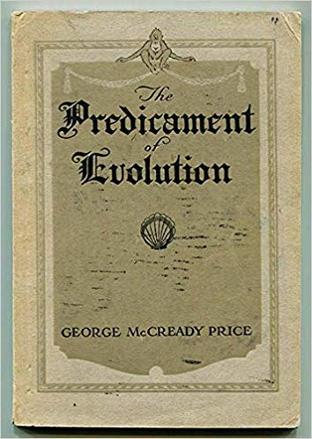
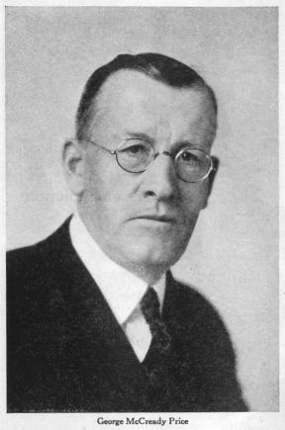
George McCready Price
W. B. Riley quoted Price in his work against Modernists.
His sermons were quoted by a number of Fundamentalist leaders.
As the issue of evolution was popularized by William Jennings Bryan and others during 1920s, Price became increasingly influential in Fundamentalist circles.

Slide 44
Adventism & Fundamentalism: Part 3
Michael W. Campbell, Ph.D.
mcampbell@swau.edu

Slide 45
Matthew Lucio
The 1919 Bible Conference “is easily one of the most controversial meetings ever held in Adventist history.”

Slide 46
Review
Struggles within Adventism
Struggles outside of Adventism
Major shift as pioneer era comes to an end.

Slide 48
Notes:
65 individuals. 1/3rd were under the age of 40.
Youngest was 26 teaching at Southern Junior College.

Slide 49
Secret Conference?!
The conference was held by invitation only. Holmes and Washburn asked about the conference. E. F. Albertsworth replied that the meeting was for the benefit of leading workers and not for ordinary workers or the common people.
Toxic atmosphere created by Holmes and Washburn meant that church leaders wanted to create a safe environment to discuss issues.
GC Committee extended invitations as to who could attend.
Shows a growing gap between church leadership and laity.
Notes:
Wirth > his students approached him before the conference began to promise them he would tell them all about the conference when he got back. “I’m not going to tell them everything about it. I will ask the Lord to give me wisdom… immature minds getting a hold of this.”
Union president > published in pamphlet form > used against us.
Sow seeds of division and discord > not in favor
AGD > sometimes think it would be just as well to lock up this manuscript in a vault.
If transcript got out, it would shake the church > most church members not able to handle it > elitist snobbery? You decide.

Slide 50
Notes:
Topics: Covenantal theology, Eastern Question, Revelation 13, Matthew 24, US in Prophecy, 2160 day prophecy, seven trumpets, and how to best understand the inspiration of Ellen White. All boiled down to three areas of study: Prophecy, Inspiration, and the Nature of God. Daniells called them “The Fundamentals.”

Slide 51
Opening Address
“Whenever the people of God are growing in grace, they will be constantly obtaining a clearer understanding of His word. They will discern new light and beauty in its sacred truths. This has been true in the history of the church in all ages, and thus it will continue to the end. But as real spiritual life declines, it has ever been the tendency to cease to advance in the knowledge of the truth. Men rest satisfied with the light already received from God's word and discourage any further investigation of the Scriptures. They become conservative and seek to avoid discussion.
Notes:
Daniells quotes Ellen G. White

Slide 52
Opening Address
“The fact that there is no controversy or agitation among God's people should not be regarded as conclusive evidence that they are holding fast to sound doctrine. There is reason to fear that they may not be clearly discriminating between truth and error. When no new questions are started by investigation of the Scriptures, when no difference of opinion arises which will set men to searching the Bible for themselves to make sure that they have the truth,” Ellen G. White (7T 706, 707).
Notes:
Daniells describe the church as in a crisis.
”I think that we have come to a crisis.” Transcript: Several Amens.
What kind of a crisis? Why was there a gap between leaders and members?

Slide 53
Notes:
How did we get to the point where people like Holmes and Washburn would steal Ellen White manuscripts?
War between the liberals versus the Fundamentalists.
Daniells made it easy for them to hate them. Smartest people meeting in “secret” > impression

Slide 54
Bible Translations
Notes:
Bible translations. H. C. Lacey praised the Rotherheim version of the Bible.
Prescott: Basis of authoritative public teaching?
Lacey: “No translation is infallible”
Why controversial? New translations were often based on Wescott and Hort’s Greek NT. Many Fundamentalists saw them as villains because Greek text was missing words or verses (not even in the oldest manuscript). Conspiracy minded Fundamentalists > conspiracy to undermine the Bible.
A. T. Jones advertised a Greek Lexicon to Wescott & Hort in 1890s.
A year later (1882) recommending new Bible translation.
Lacey could calmly recommend the Rotherhem translation > based on Wescott & Hort’s text.
Wirth: what do we do when there is a conflict between King James and Revised Version? What he meant, what does it mean when Ellen White chose one translation in one spot versus another?
Does Ellen White indicate that the translation she chose was the right or perfect one, now how Adventists should be reading
Ellen White used whatever version best fit her point.

Slide 55
Trinity
Notes:
15 Fundamental Beliefs (1913) First one read: SDAs believe in the divine trinity.
1919 > 15 expanded to 22 > trinity remained word for word
Growing less afraid of that word > provoked discussion on the topic.
40 years publishing a book that Jesus was not co-eternal with the Father—that is Arianism. “Do we want to go on teaching that?” Probably Smith’s D&R.
Come to represent early Adventism as a whole.
To critize that book was ministry suicide > why he didn’t name the book.
Lacey > gets that question about nature of Christ every year in two classes > stands firm. Of course they believed he was divine, but NOT eternal. Created at some point. Where they differed > they believed he was created.
Prescott found himself stumbling to describe the nature of God > had not found a way to harmonize all the texts on the subject > in a way that would tempt conservatives to convert to his position.
One school > Jesus existed forever > another school > can we pleaes take a position?
Daniells stepped in > “Now let us not get a bit nervous or scared. Let’s not let conservatives think that something is going to happen and the progressives get alarmed for fear that it won’t happen.”

Slide 56
609 × 343
Notes:
On December 11, 1917, General Edmund Allenby, commander of the British “Egyptian Expeditionary Force,” entered Jerusalem, two days after the Turkish forces occupying the city raised the white flag before Allied forces.

Slide 57
Prophetic Interpretation
Uprooting of three horns (538 AD) that would last until 1798 AD) when Napoleon imprisoned the Pope.
Prescott urged not to “abandon the eights.”
Progressives (Lacey, Prescott, and Harry Washburn).
W. T. Knox (conservative) urges them to pursue the truth wherever it leads.
Prescott: “I would like to be understood as a conservative.” [stenographer noted there was laughter] “I don’t think we should look at opportunities to change what we have taught. We should start with the idea that this message is the true message and we are not hear to tear it down.”
Notes:
Does not prove it cannot be changed. We should advance in the light.

Slide 58
Daily Controversy
Focal point Daniel 8 with ”the daily sacrifice” and the “transgression of desolation.”
Conradi led the way in a new view during the 1890s referring to the “daily” intercession of Jesus in heaven.
Both views had their origins all the way back to the Millerite movement. Plus Adventist expositors know that the word “sacrifice” was added.
Topic so hot that Daniells forbid discussion on the topic unless he was in the room. He later said he wished he could put the “daily” in a hot air balloon and let it float away.
Ellen White urged them (1908) to stop fighting over this issue.
Notes:
Valentine > “storm in a tea cup”
1850 made a statement that “daily” was about pagan and papal Rome
The real issue wasn’t Daniel 8 > the fact that Ellen White put her stamp of approval on this interpretation. Another interpretation would undermine Ellen White.

Slide 59
The Eastern Question

Slide 60
1911 Great Controversy

Slide 61
Progressives
Developed a flexible hermeneutic.
Knew Ellen White personally.
Recognized significance of Fundamentalist movement.

Slide 62
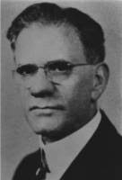
B. G. Wilkinson
Leader of the Traditionalists.

Slide 63
Discovery of Transcripts

Slide 64
Ghosts
Last Generation Theology
Gender Discrimination
Racial segregation

